Slide 1
Donor Research

Slide 2
Ways to donate money
One time donation - a payment to the organization that is only made once
Monthly pledges and sponsorships - committing be giving a fixed amount of money for an extended time period
Honor and memorial gifts - donating in the name/honor of a loved one
Workplace giving - contributions from payroll that are matched by one’s company
Offline donations - donations mailed in or arranged by phone
Planned or Legacy giving - a donation arranged to be allocated at future date (usually granted once donor passes)
Corporate sponsors and partnerships - for-profits that join with non-profits for social and philanthropic initiatives
Stocks - long appreciated securities (stock, bonds, mutual funds, etc…) donated directly to non-profit

Slide 3
Other methods of support
Gift catalogs - buying essential goods and services through the non-profit’s catalog
Peer-to-peer and Personal fundraising - fundraising for the non-profit using the tools it provides
Gifts in kind - donating essential goods and services
Advocating - becoming a voice for the organization
Food Drives - organizing, volunteering, or fundraising for stockpiling and delivering food
Donating cars - donating old vehicles to the non-profit
Purchase proceeds - shopping at the non-profit or with an affiliate of the non-profit that sends its proceeds to the cause

Slide 4
Other Non-Profit Website’s Strengths
Easy to Find Donation Pages | Multiple donation buttons and ways to donate | FAQ about donating | Where the donation goes to | Good Corporate Partner pages
ASPCA Habitat for Humanity Teach for America Feeding America Disabled American Vets | ASPCA Habitat for Humanity | ASPCA Feeding America | Feeding America World Vision Disabled American Vets Habitat for Humanity | Feeding America World Vision Habitat for Humanity

Slide 5

Other Non-Profit Website’s Weaknesses
Not enough information about each way of donating | No descriptions on what each amount pays for | No online donation cap off | Optional fees/have to become a member to donate
Feeding America World Vision Disabled American Vets Teach for America | Habitat for Humanity Teach for America World Vision Disabled American Vets | ASPCA Teach for America Feeding America Disabled American Vets | World Vision Disabled Vets

Slide 6
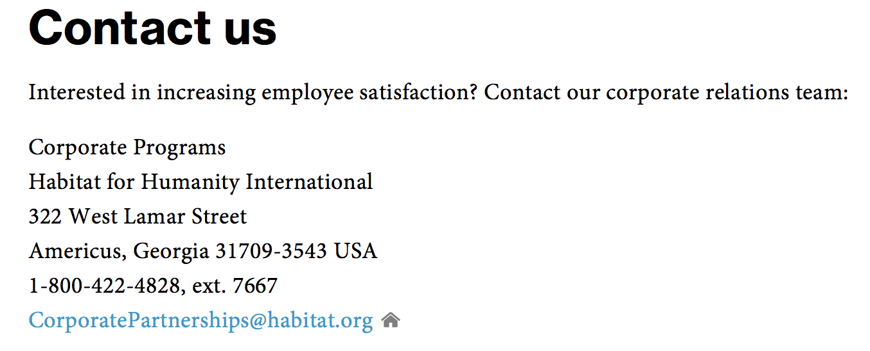
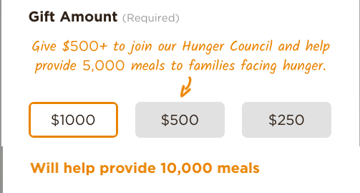
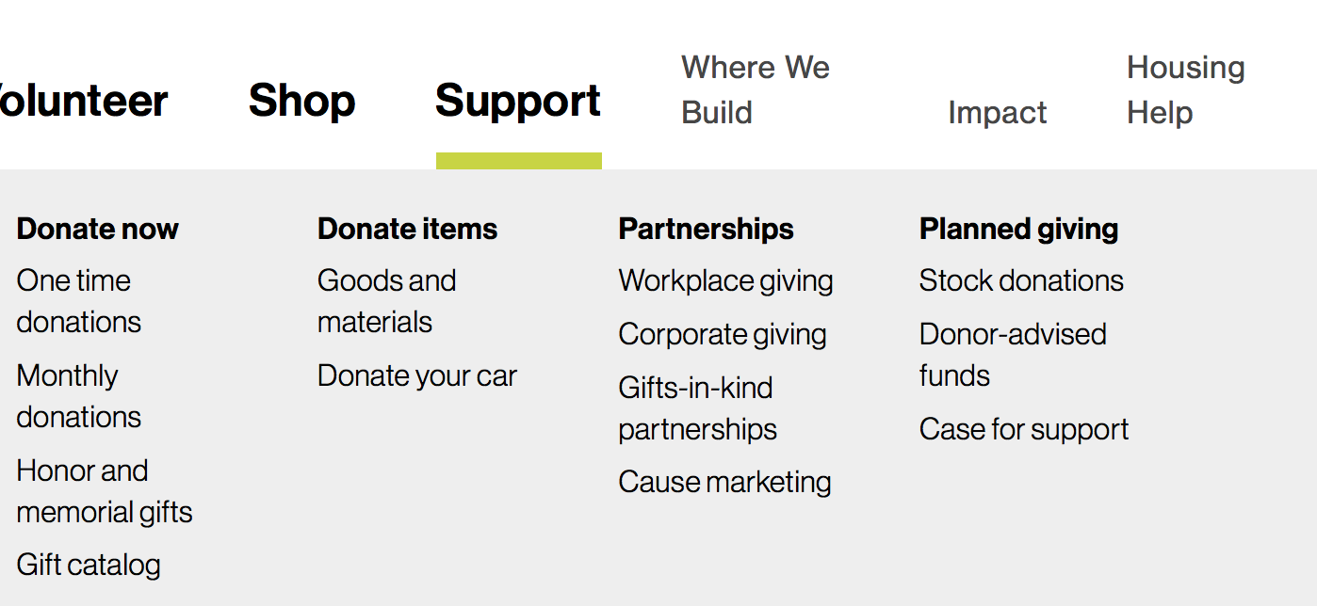
Website Pros
Habitat for Humanity:
Corporate specific program information
All the ways to donate in one place
Feeding America:
Each donation amount gives a summary of how many meals it will help provide
Minimalistic, easy to navigate Donation page with engaging colors

Slide 7
Individual Donation Page
Pros
Straightforward and understandable on how to give
Some list steps on how to donate
Some list how your contribution will help
Donation FAQ
Cons
Usually did not list an online donation limit
Not all the sites have a donation related help number listed
Notes:
More info for pros and cons

Slide 8
Corporate Partners Donation Page
Pros
Contact information is listed
Easy to find through the give pages
Was able to search for corporate donors through a search bar on most of the organizations’ sites
All had lists of corporate sponsors
Cons
Not all sites described this type of giving
Sometimes hard to find IF give page was hard to find too
Most only had about 1 form of contact (i.e. email or phone)

Slide 9
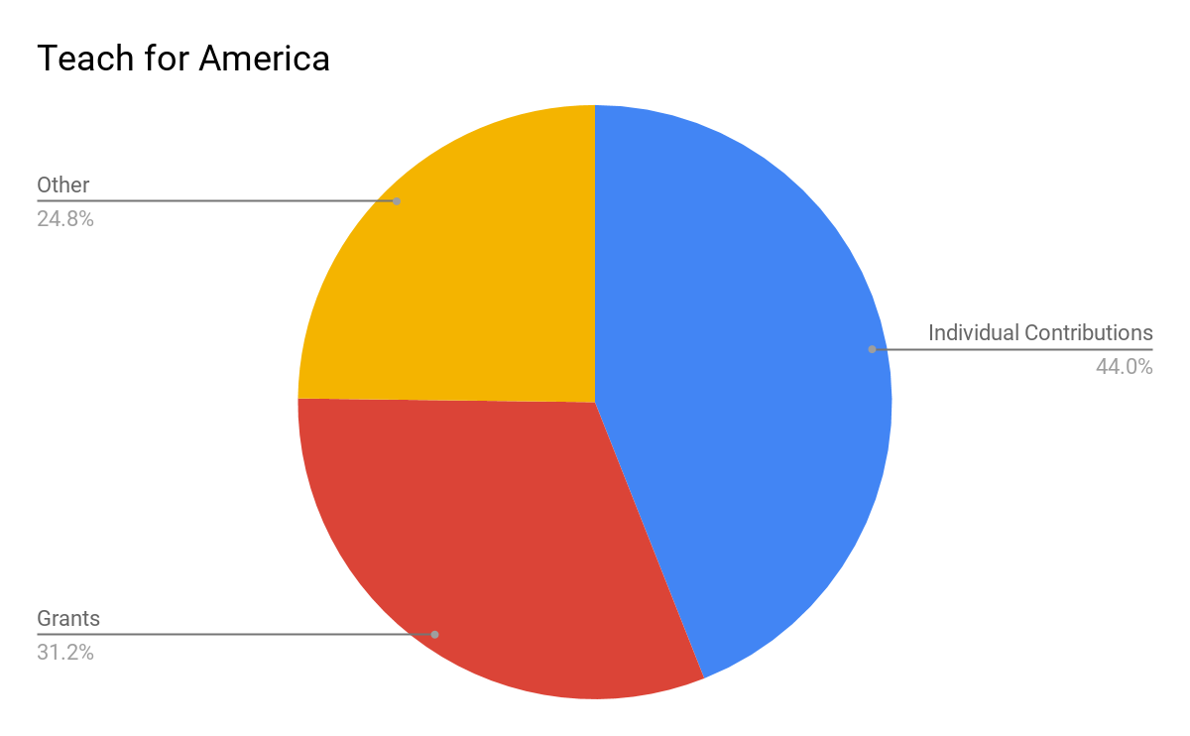
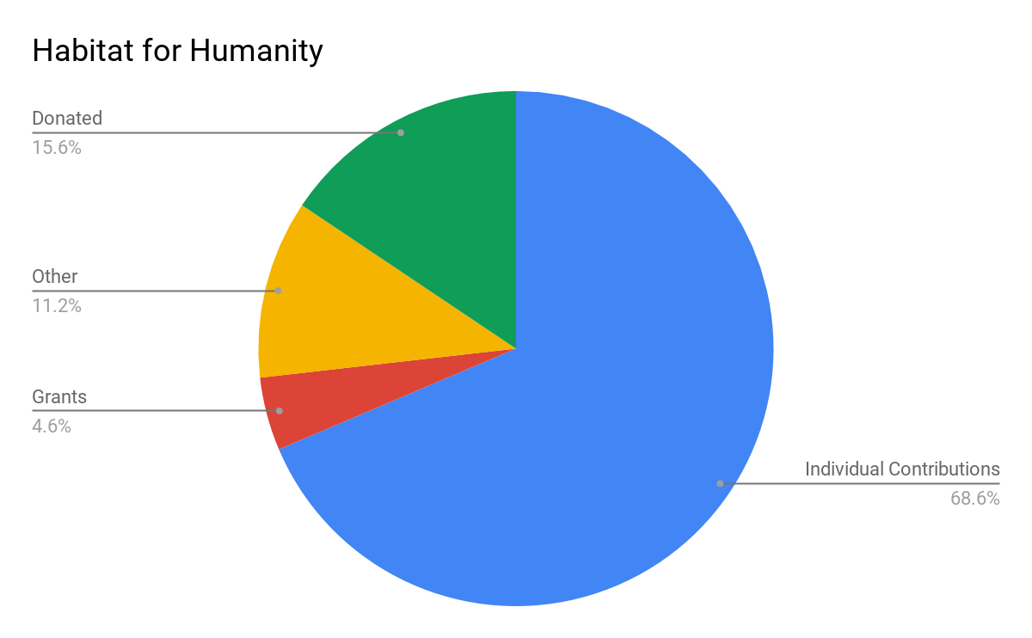
Financials
Notes:
Have all colors be the same, make terminology correlate

Slide 10
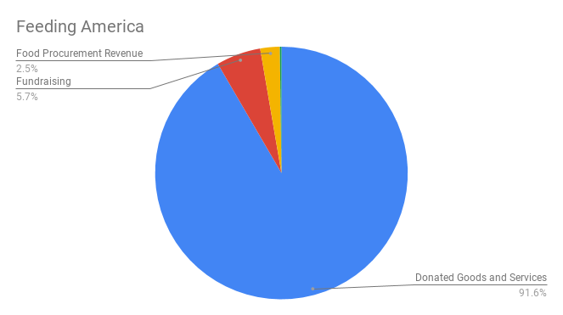
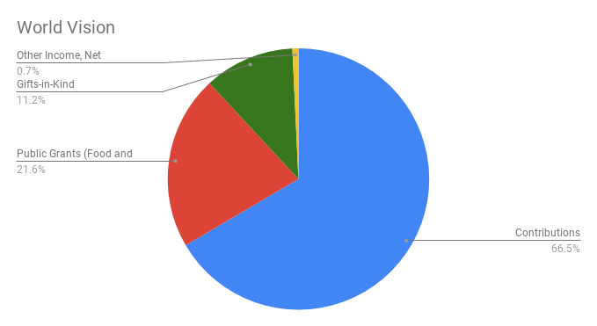
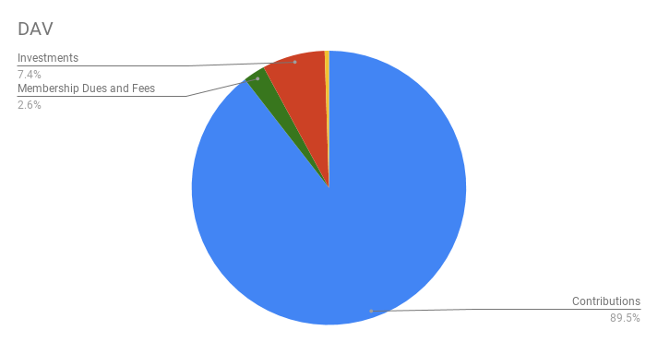
Financials
Notes:
Colors + terminology

Slide 11
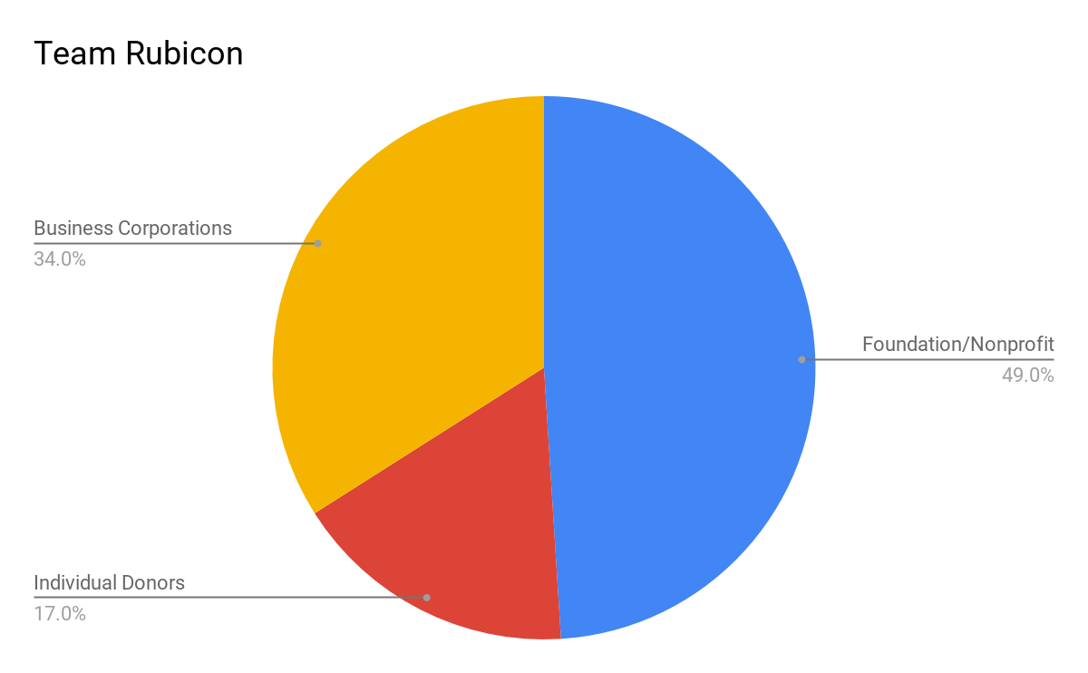
Financial- Team Rubicon
On average, the other organizations had individual/private contributions as highest percent
Notes:
Have a strength/weakness chart for TR, use TR as model for other pie charts

